Slide 1
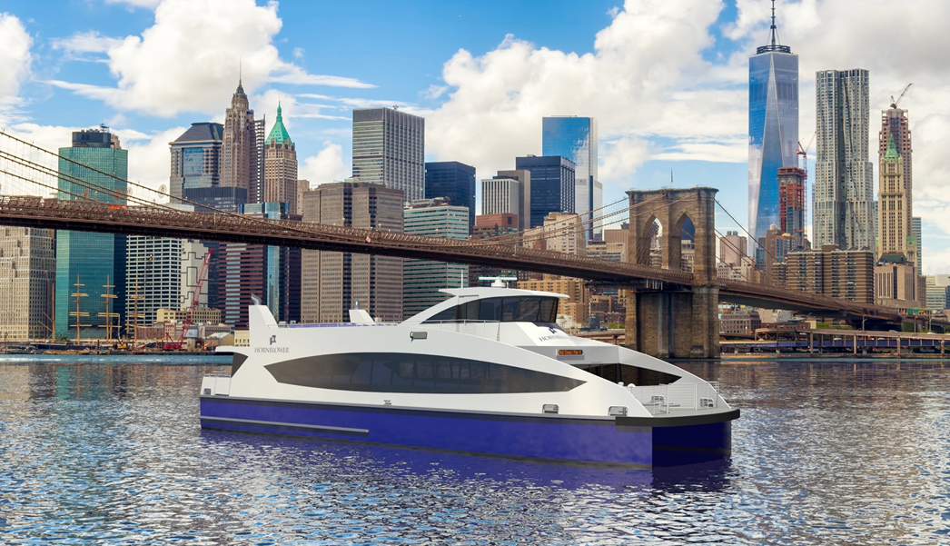
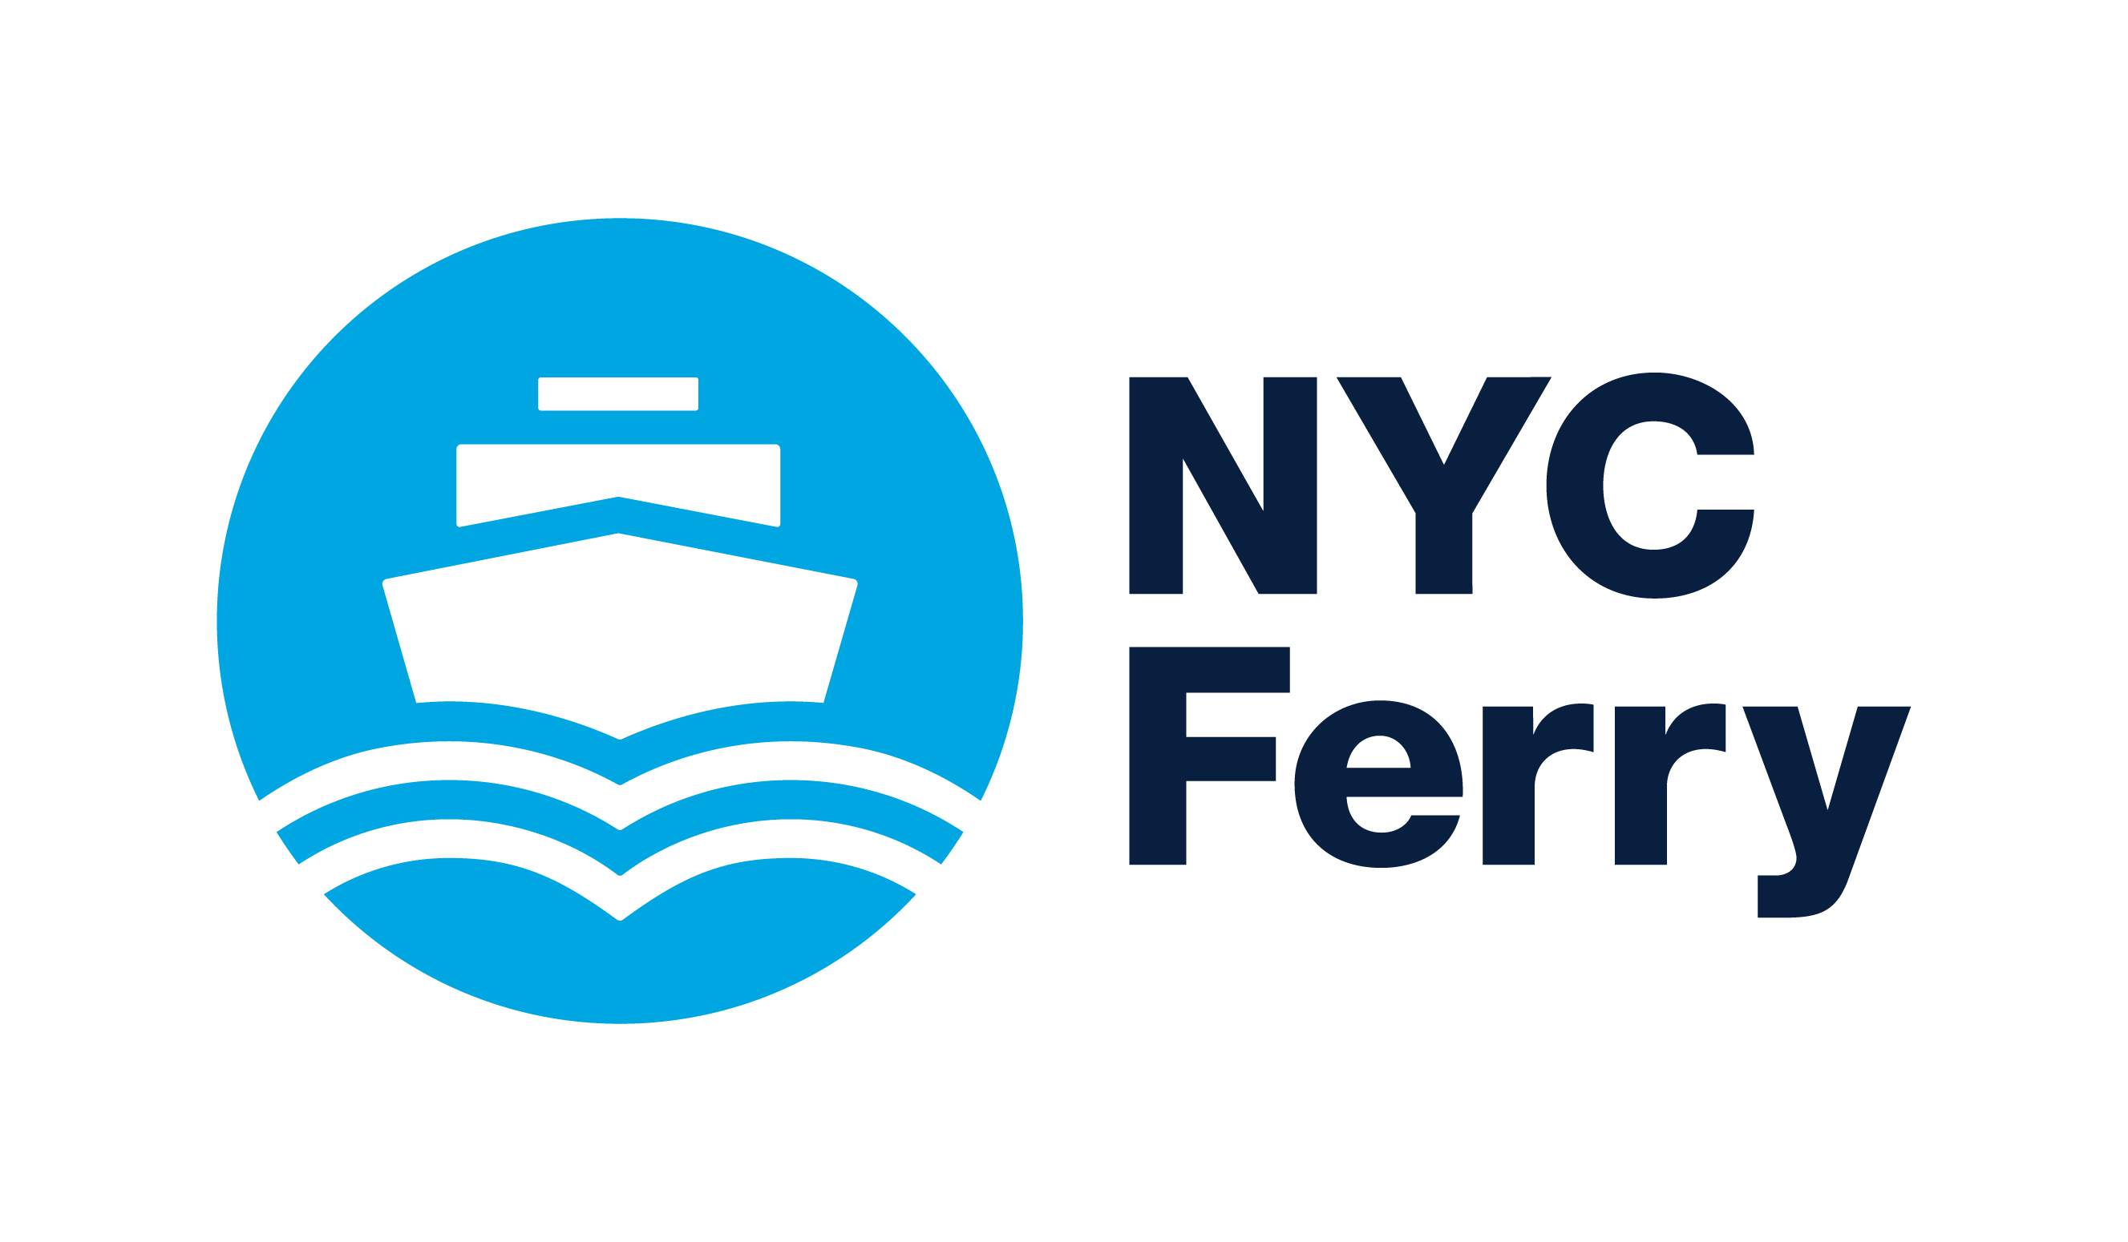
Training Today
May 11, 2017
Ferry Safety & Technology Conference
May 11, 2017

Slide 2
Background
Richard J. Paine, Jr.
Regional Director, HSSQE
Hornblower
551.655.0028
rpaine@hornblower.com
Master 100GT, Near Coastal
3rd Mate Unlimited, Oceans
ISO / ISM Auditor
Over 20 years of Maritime Experience
SUNY Maritime College Alumnus
2016 Recipient of “Excellence in Editorial” Award for FogHorn Magazine (Accountability & Consistency: A key mixture for safety success)

Slide 3
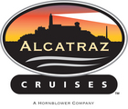
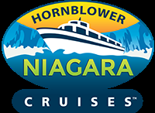
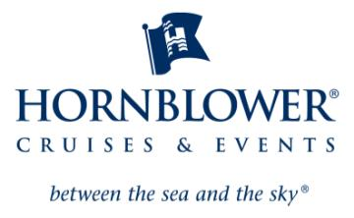
Hornblower

Slide 4
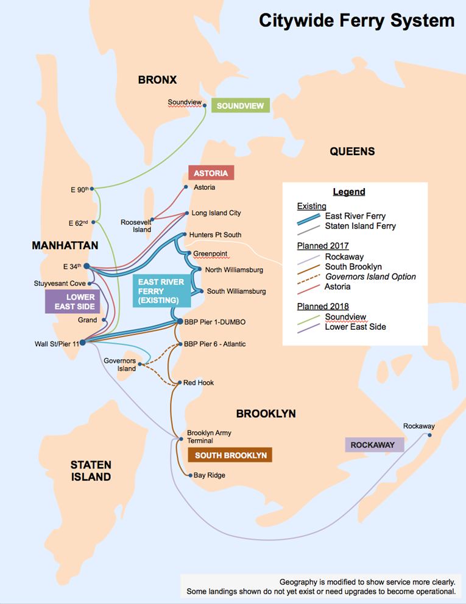
NYC Ferry is born
NYC Ferry awarded to Hornblower in 2016
19 newly constructed vessels
New Routes. New Neighborhoods.
May 01 Launch

Slide 5
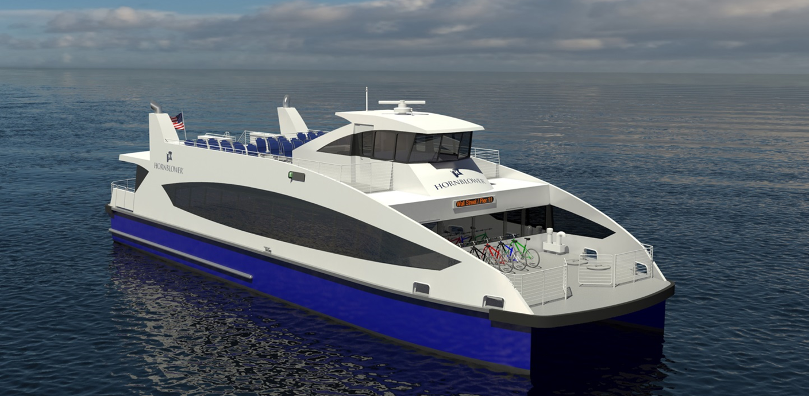
New Boats. New Captains. New Commuter Ferry Service.
Features:
-New Construction
-Low-wake design
-EPA Tier 3 Engines (best for vessel class)
-150 passenger capacity
-Bicycle, wheelchair and stroller parking areas

Slide 6
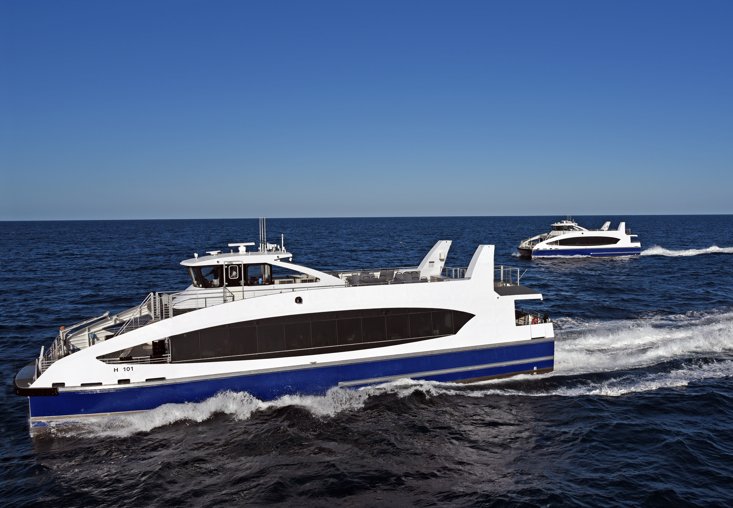
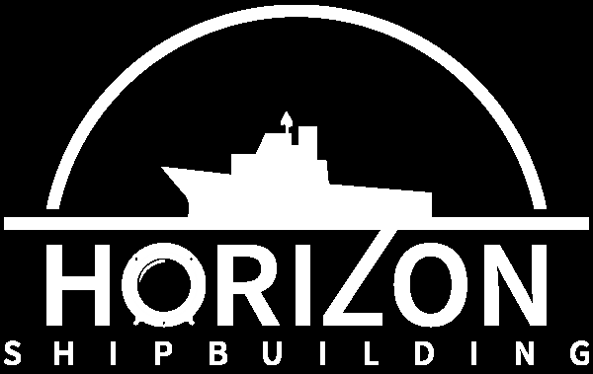
Two Shipyards

Slide 7
The Question
How do we train our Captains and crew within the tight start-up schedule and delivery of vessels?

Slide 8
The Solution
AM New York - NYC Ferry Simulator

Slide 9
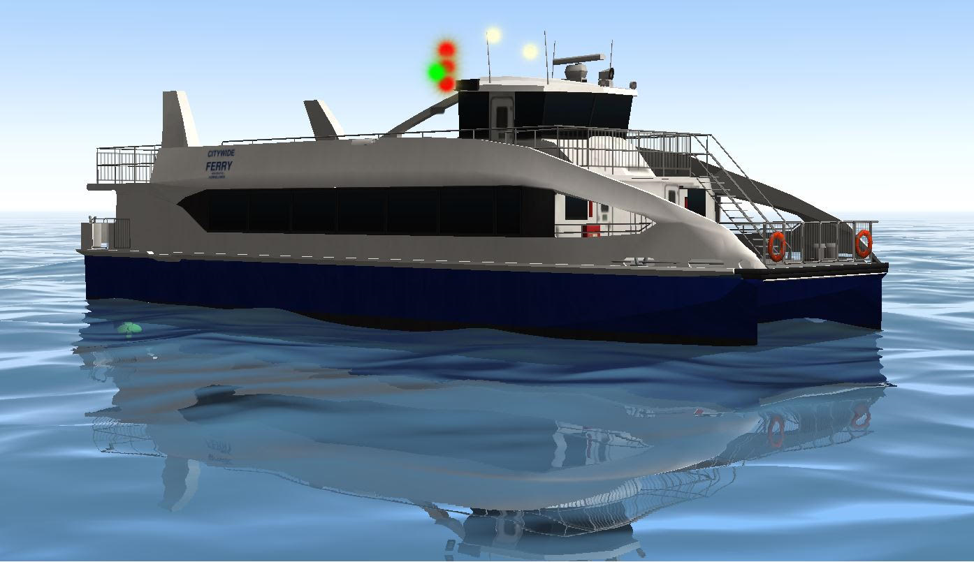
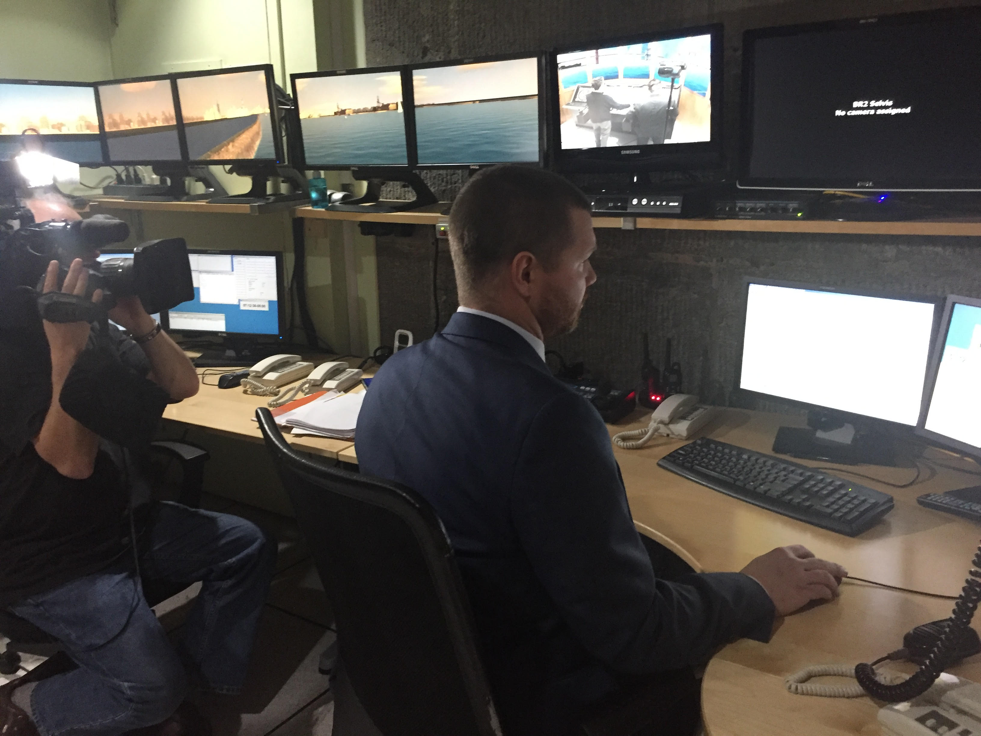
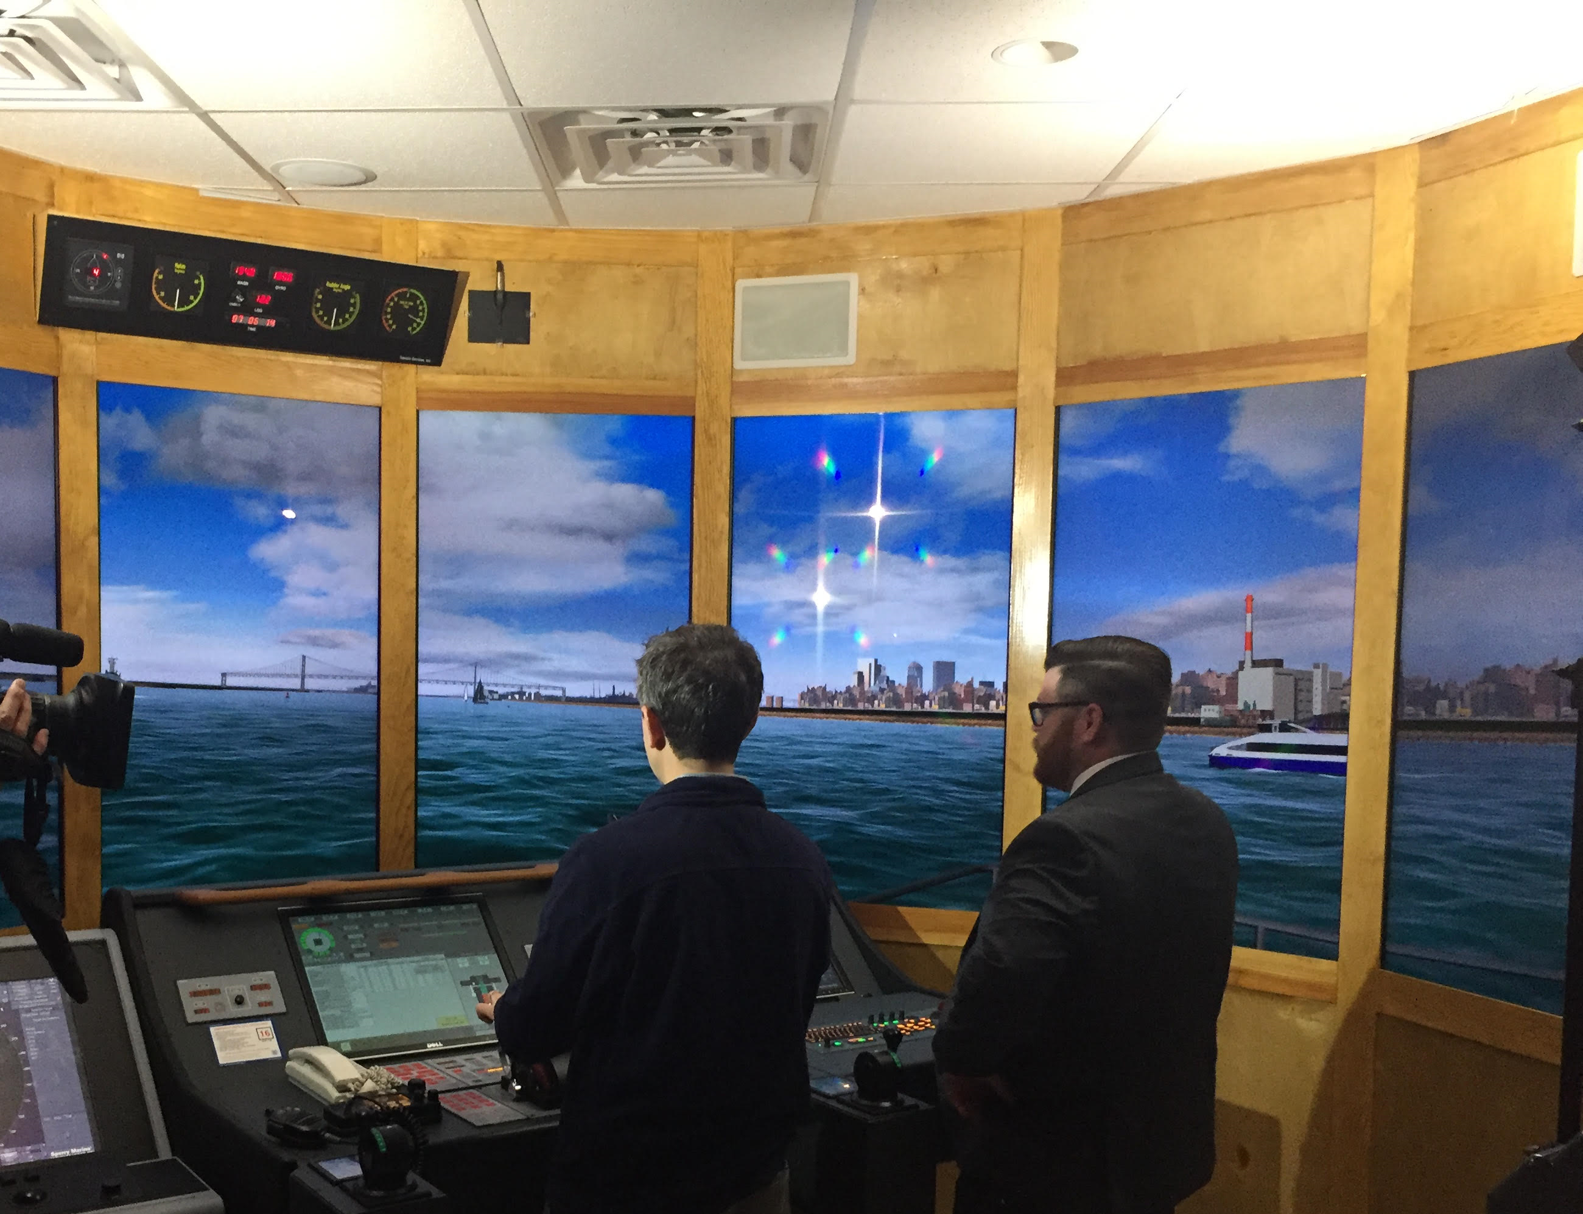
Innovative Technology
Introduce simulator training technology traditionally reserved for larger maritime industry into commuter ferry service
SUNY Maritime College (Training Hub)
Transas America (Software)
Network of Simulators available in New York City
Law Enforcement
Local Harbor Schools & Training Institutes

Slide 10
Lasting thought
Simulation training alone will not prepare a Captain to fully master a vessel, but when used correctly, it can be a critical tool that helps build a mariner’s confidence and ultimately succeed.

